Slide 1

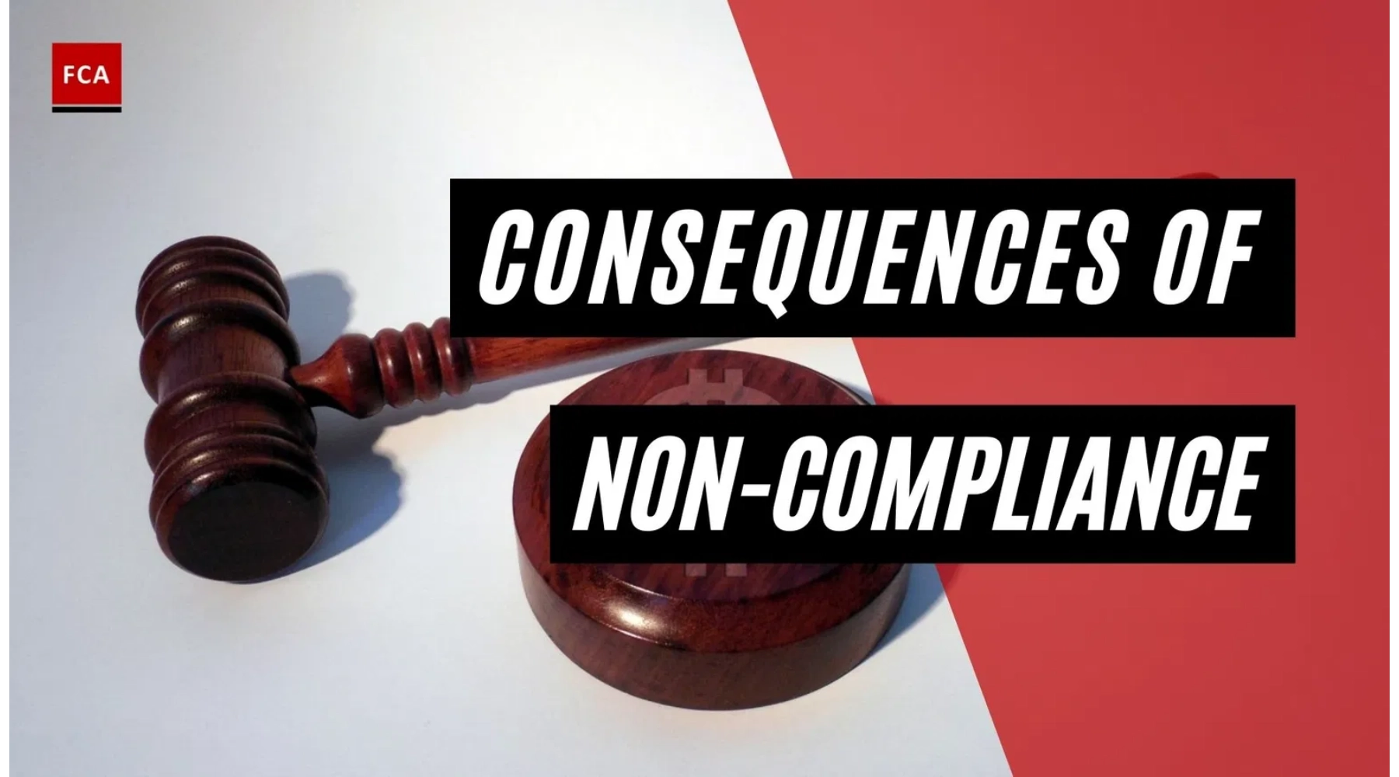
Legal Implications of Non-Compliance
GRC104 - Compliance Frameworks and Legal Requirements
International Cybersecurity and Digital Forensics Academy
Week 18: November 10-16, 2025

Slide 2

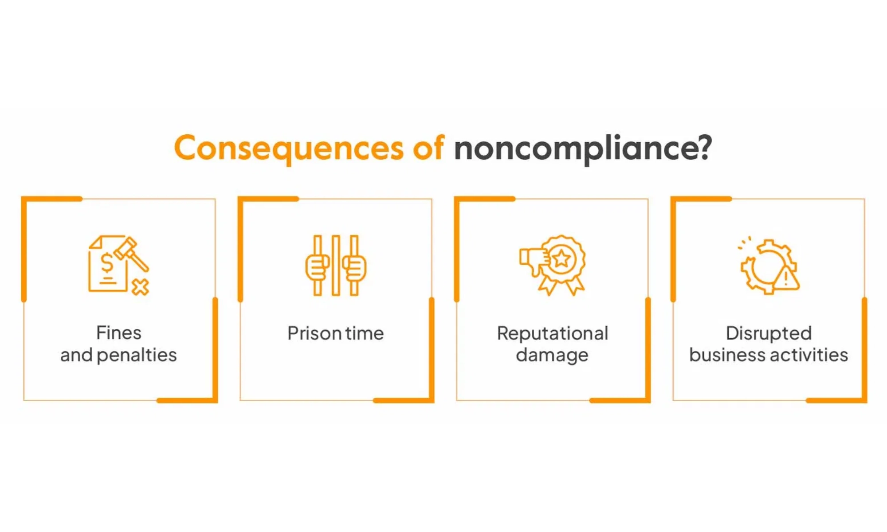
Introduction to Non-Compliance
Definition:
Non-compliance refers to the failure of an
organization or individual to adhere to applicable laws,
regulations, standards, or contractual obligations that govern
their operations and activities.
Significance
• Regulatory enforcement increased by 58% globally since 2020
• Cost of non-compliance is 2.71 times higher than maintaining compliance
Key Dimensions of Non-Compliance
Intentional vs. Unintentional
- Deliberate violations vs. oversight or misunderstanding
• 65% of organizations experienced at least one significant compliance violation in the past two years
Systemic vs. Isolated
- Pattern of failures vs. one-time incidents
This presentation examines the multifaceted legal consequences that can result from non-compliance with regulatory requirements across various industries and jurisdictions.
Self-reported vs. Discovered
- Voluntary disclosure vs. regulatory investigation
Technical vs. Substantive
- Procedural errors vs. fundamental violations

Slide 3

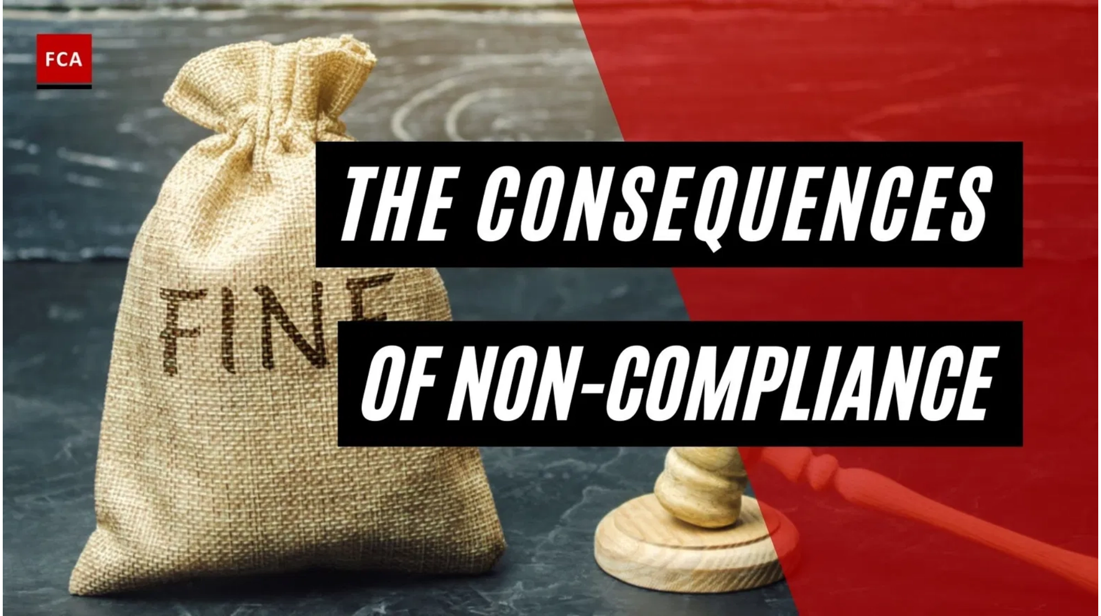





Types of Legal Implications
Non-compliance can trigger multiple, overlapping legal consequences that affect organizations at various levels, creating cascading effects throughout the organization.
Primary Legal Implications
Financial Penalties
Monetary sanctions imposed by regulatory authorities, ranging from thousands to billions of dollars.
Criminal Liability
Administrative Actions
Prosecution of both organizations and individuals that can result in imprisonment.
Regulatory interventions including cease-and-desist orders, license restrictions, and enhanced oversight requirements.
Civil Liability
Reputational Damage
Lawsuits from affected parties seeking damages, including class actions and shareholder suits.
While not strictly legal, reputational harm has significant legal and financial implications through lost business and reduced market value.

Slide 4

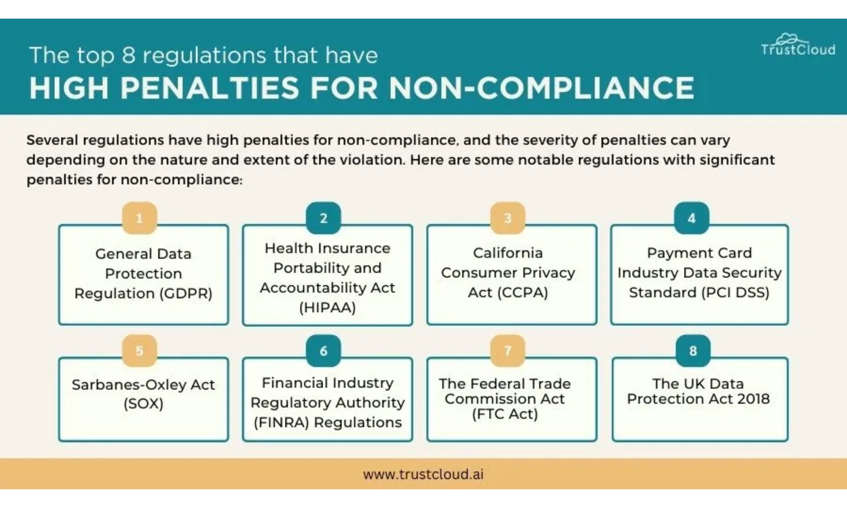
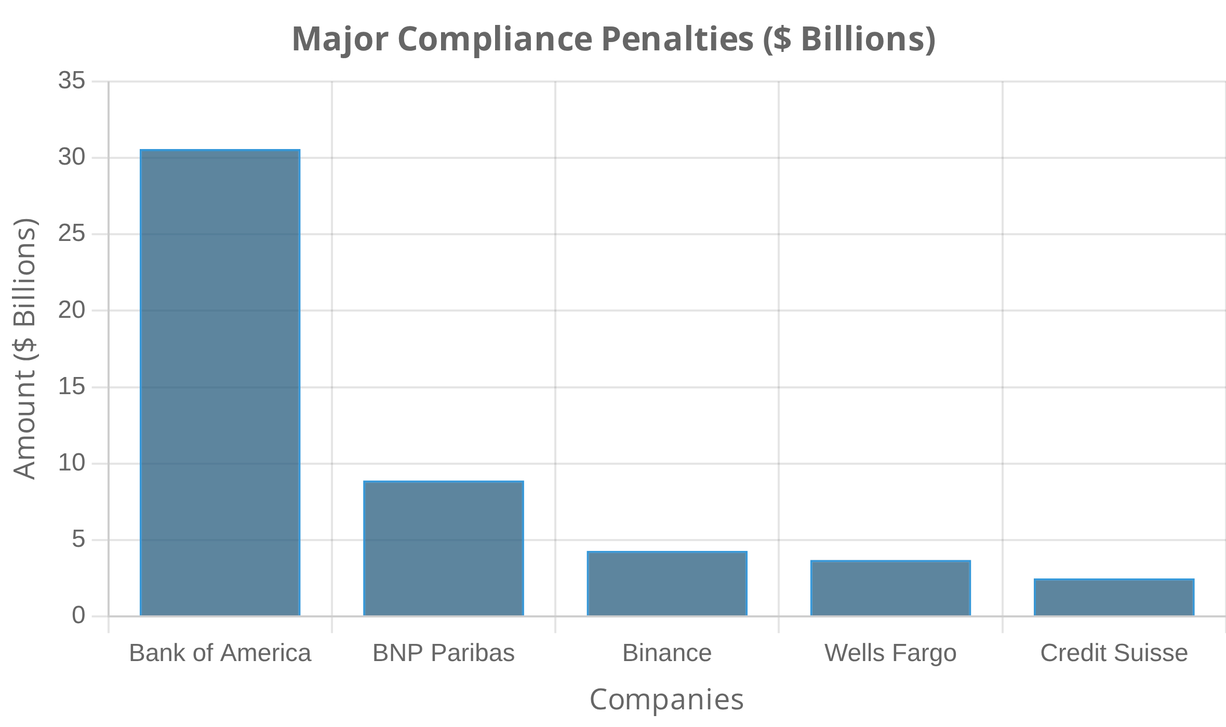






Financial Penalties and Monetary Sanctions
Financial penalties for non-compliance have reached unprecedented levels in recent years, with regulators increasingly willing to impose billion-dollar sanctions for serious violations.
Notable Recent Penalties
Penalty Determination Factors
Severity and duration of the violation
Harm caused to consumers or markets
Prior compliance history of the organization
Self-disclosure and cooperation with authorities
Remediation efforts and compliance improvements
Intentional nature of the violations
Beyond direct penalties, organizations face additional financial impacts including legal defense costs, remediation expenses, business disruption, increased insurance premiums, and costs of enhanced compliance programs.

Slide 5

Criminal Liability for Non-Compliance
Corporate Criminal Liability
Recent Criminal Prosecutions
Organizations can be held criminally liable for acts of employees when:
Case
Individuals
Outcome
The employee acted within the scope of employment
USAID Bribery (2025)
4 executives
Guilty pleas, pending sentencing
The employee acted, at least in part, to benefit the company
The conduct can be imputed to the organization
Cred LLC Fraud (2025)
CEO and CFO
52 months and 36 months imprisonment
Individual Criminal Liability
Medicare Fraud (2023)
Chief Compliance Officer
Prison sentence
Executives and employees face increasing personal criminal exposure:
South Florida Telecom (2024)
CEO
5 years imprisonment, $128M payment
"Responsible Corporate Officer" doctrine allows prosecution without direct involvement
Department of Justice emphasis on individual accountability (Yates Memo)
Sentencing Considerations
Whistleblower protections and incentives increasing exposure
Federal Sentencing Guidelines provide framework with factors including:
Compliance program effectiveness
Self-reporting and cooperation
Level of involvement and history
Average sentence for white-collar offenders: 17-36 months

Slide 6

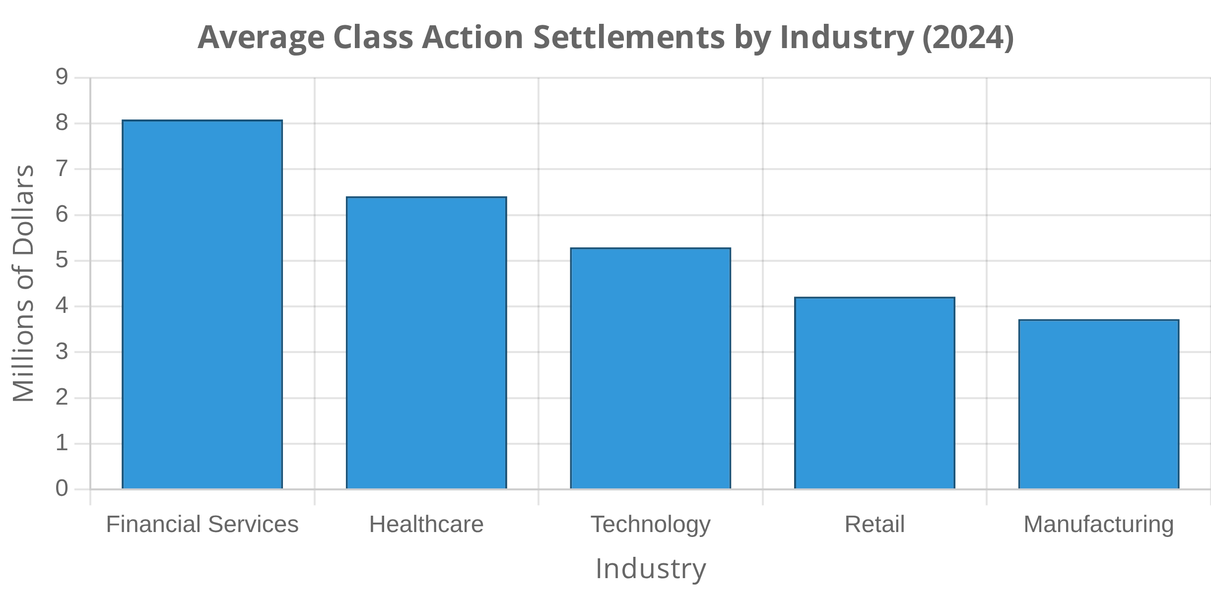
Civil Liability and Private Actions
Private Rights of Action
Many regulatory statutes create explicit private rights of action, allowing affected parties to sue for damages under:
Securities laws (10b-5 actions)
Antitrust laws (treble damages)
Consumer protection statutes
Environmental protection laws
Data privacy regulations (CCPA, GDPR)
Shareholder Derivative Suits
Class Action Lawsuits
Shareholders can sue directors and officers for breaching fiduciary duties by:
Non-compliance often triggers class action litigation that:
Aggregates claims of similarly situated plaintiffs
Failing to implement adequate compliance programs
Dramatically increases potential liability exposure
Ignoring red flags of non-compliance
Average settlement: $6.1 million in 2024
Misleading investors about compliance status
Data breach class actions increased 320% since 2020
Business Relationship Impacts
Non-compliance can create contractual liability through breach of compliance representations, indemnification obligations, termination of key contracts, and exclusion from business opportunities requiring compliance certification.

Slide 7
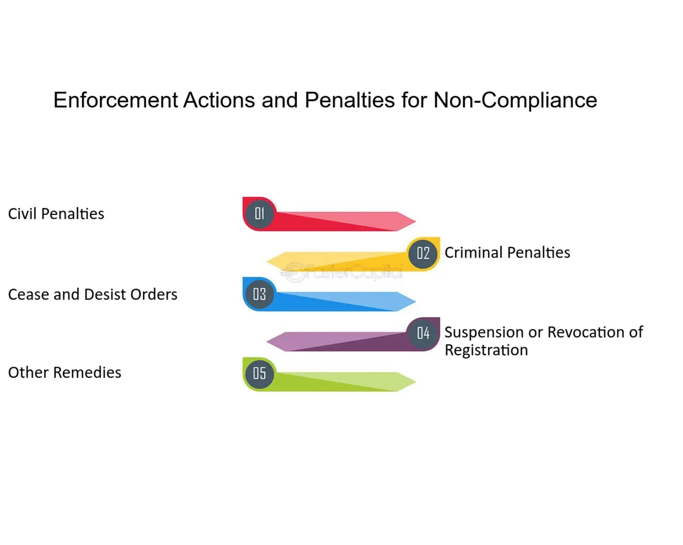

Administrative and Regulatory Actions
Regulatory agencies possess broad administrative powers to address non-compliance beyond financial penalties. These powers can significantly impact an organization's ability to operate and often have more immediate effects than court proceedings.
Types of Administrative Actions
Injunctions and Cease-and-Desist Orders
Regulators can immediately halt non-compliant activities, potentially shutting down critical business operations until violations are remediated.
Case Example: Banking Enforcement
Debarment and Exclusion
A major bank found non-compliant with anti-money laundering regulations faced:
Organizations found non-compliant may be excluded from government contracting opportunities, federal healthcare programs, financial markets, and industry-specific activities.
Asset growth restrictions limiting new business
Prior approval requirements for new products
Enhanced Oversight Requirements
Mandatory independent compliance monitor for 3 years
Non-compliance frequently triggers intensified regulatory supervision including mandatory independent monitors, regular reporting obligations, and heightened examination schedules.
Weekly reporting to regulators on remediation progress
License Restrictions and Revocations
Regulators can limit or revoke essential business licenses and permits necessary for operation in regulated industries.

Slide 8
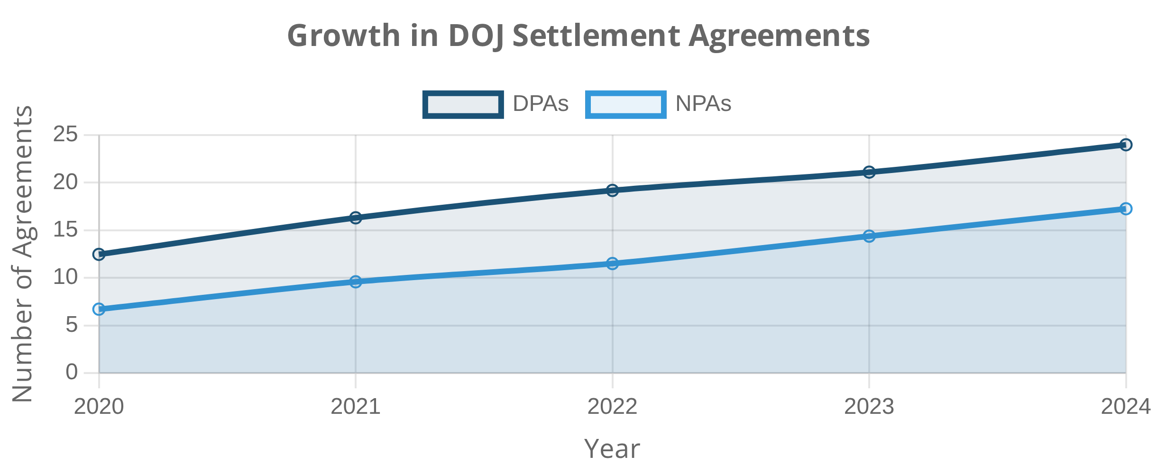



Remediation and Settlement Agreements
Regulatory authorities increasingly use structured settlement agreements as alternatives to traditional enforcement actions, allowing organizations to resolve non-compliance issues while avoiding some of the most severe consequences.
Corporate Integrity Agreements (CIAs)
Common in healthcare enforcement, allowing organizations to continue participating in federal healthcare programs despite compliance failures.
Types of Settlement Agreements
Consent Decrees
Court-enforceable agreements that resolve civil enforcement actions while mandating specific remedial measures.
Deferred Prosecution Agreements (DPAs)
Temporarily suspend criminal prosecution while the organization fulfills specific obligations. The DOJ issued 25 agreements in 2024 alone.
Settlement Agreement Trends
Non-Prosecution Agreements (NPAs)
Individual accountability requirements
Similar to DPAs but without formal charges being filed, representing a less severe alternative when organizations demonstrate exceptional cooperation.
Compliance program effectiveness metrics
Technology-based monitoring solutions

Slide 9

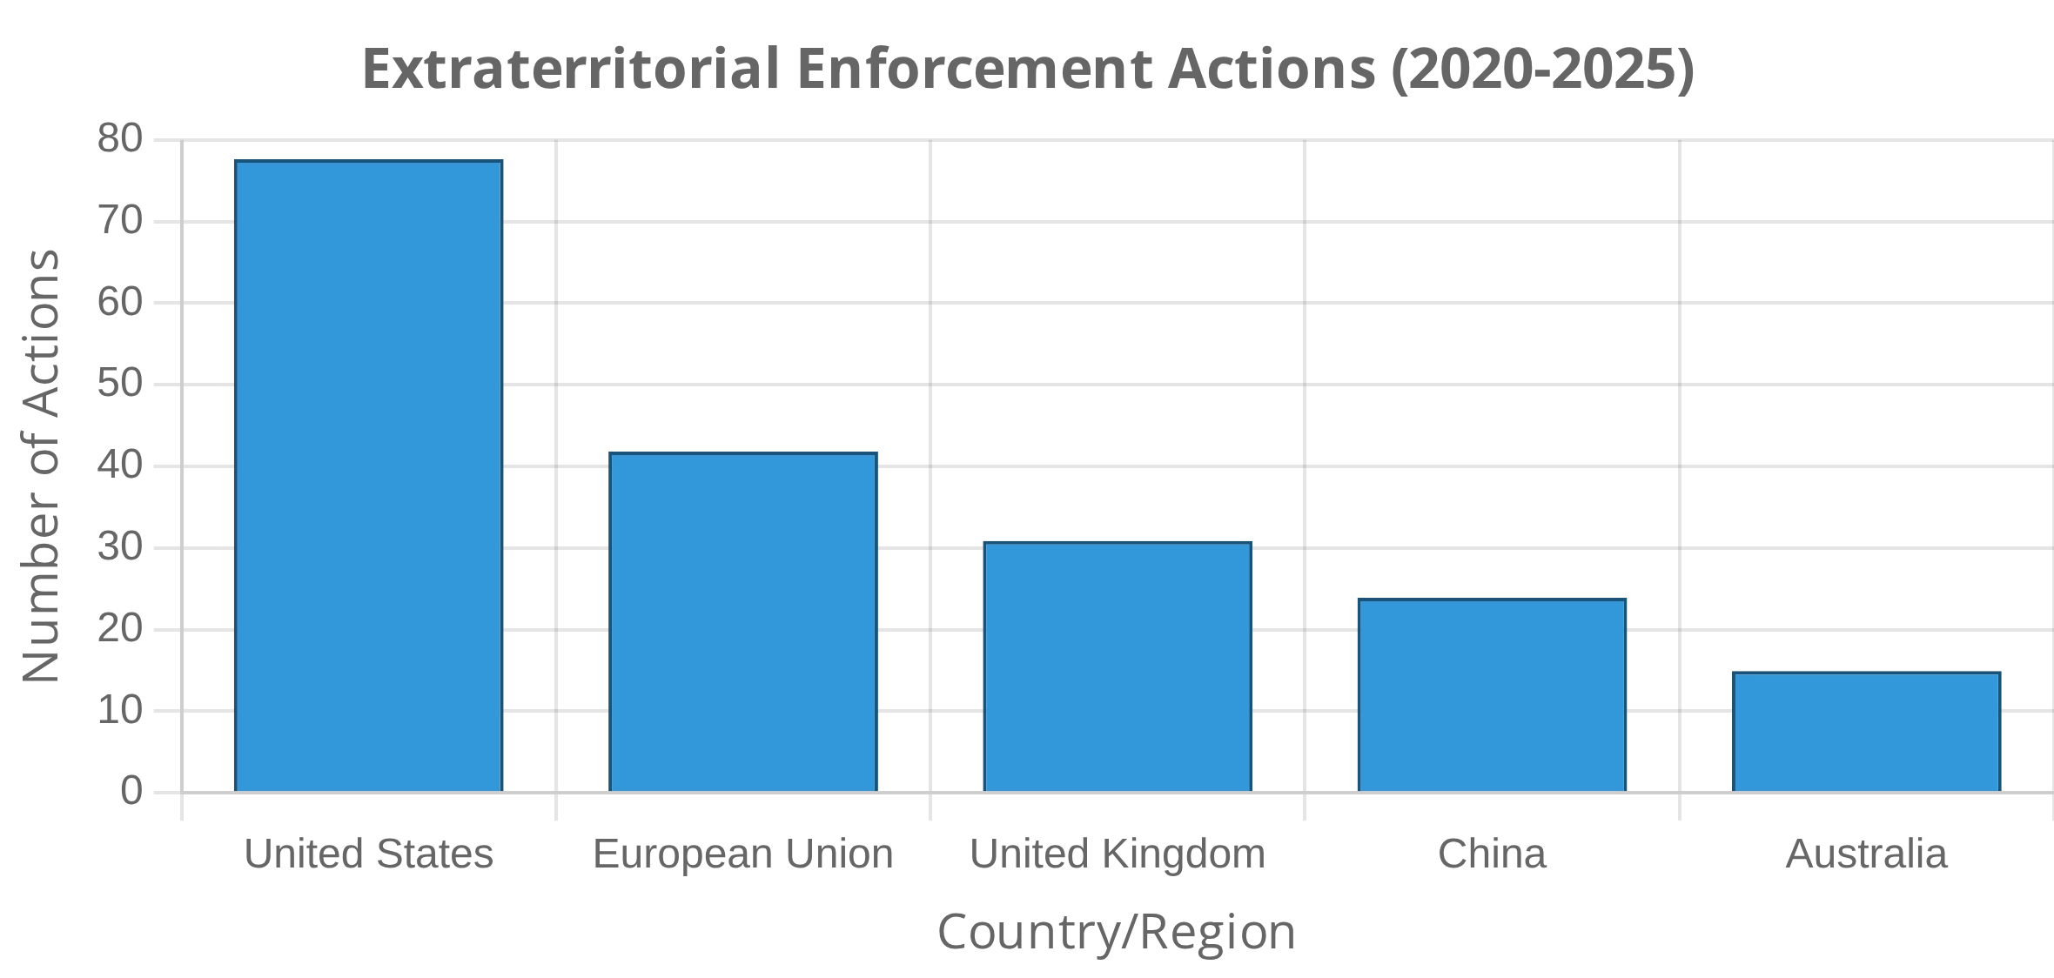
International Legal Implications
European Union Regulations
Organizations operating across multiple jurisdictions face complex compliance challenges due to overlapping and sometimes conflicting regulatory regimes. The extraterritorial application of national laws has created a particularly challenging landscape.
General Data Protection Regulation (GDPR)
- Applies to any organization processing EU residents' data
EU Competition Law
- Applies to conduct affecting EU markets regardless of location
Extraterritorial Application of Laws
Cross-Border Enforcement Cooperation
U.S. Laws with Global Reach
Foreign Corrupt Practices Act (FCPA)
Regulatory authorities increasingly collaborate across borders through:
- Prohibits bribery of foreign officials
Mutual Legal Assistance Treaties facilitating evidence sharing
CLOUD Act
Joint investigation teams coordinating complex cases
- Allows U.S. authorities to access data stored outside U.S.
Global settlements involving multiple national authorities
OFAC Sanctions
- Both primary and secondary sanctions create global obligations
Navigating Conflicting Requirements
Organizations must develop strategies for addressing conflicting legal obligations:
Jurisdictional risk assessment and prioritization
Structured decision-making frameworks for conflicts
Engagement with regulators across jurisdictions
Careful documentation of compliance rationales

Slide 10

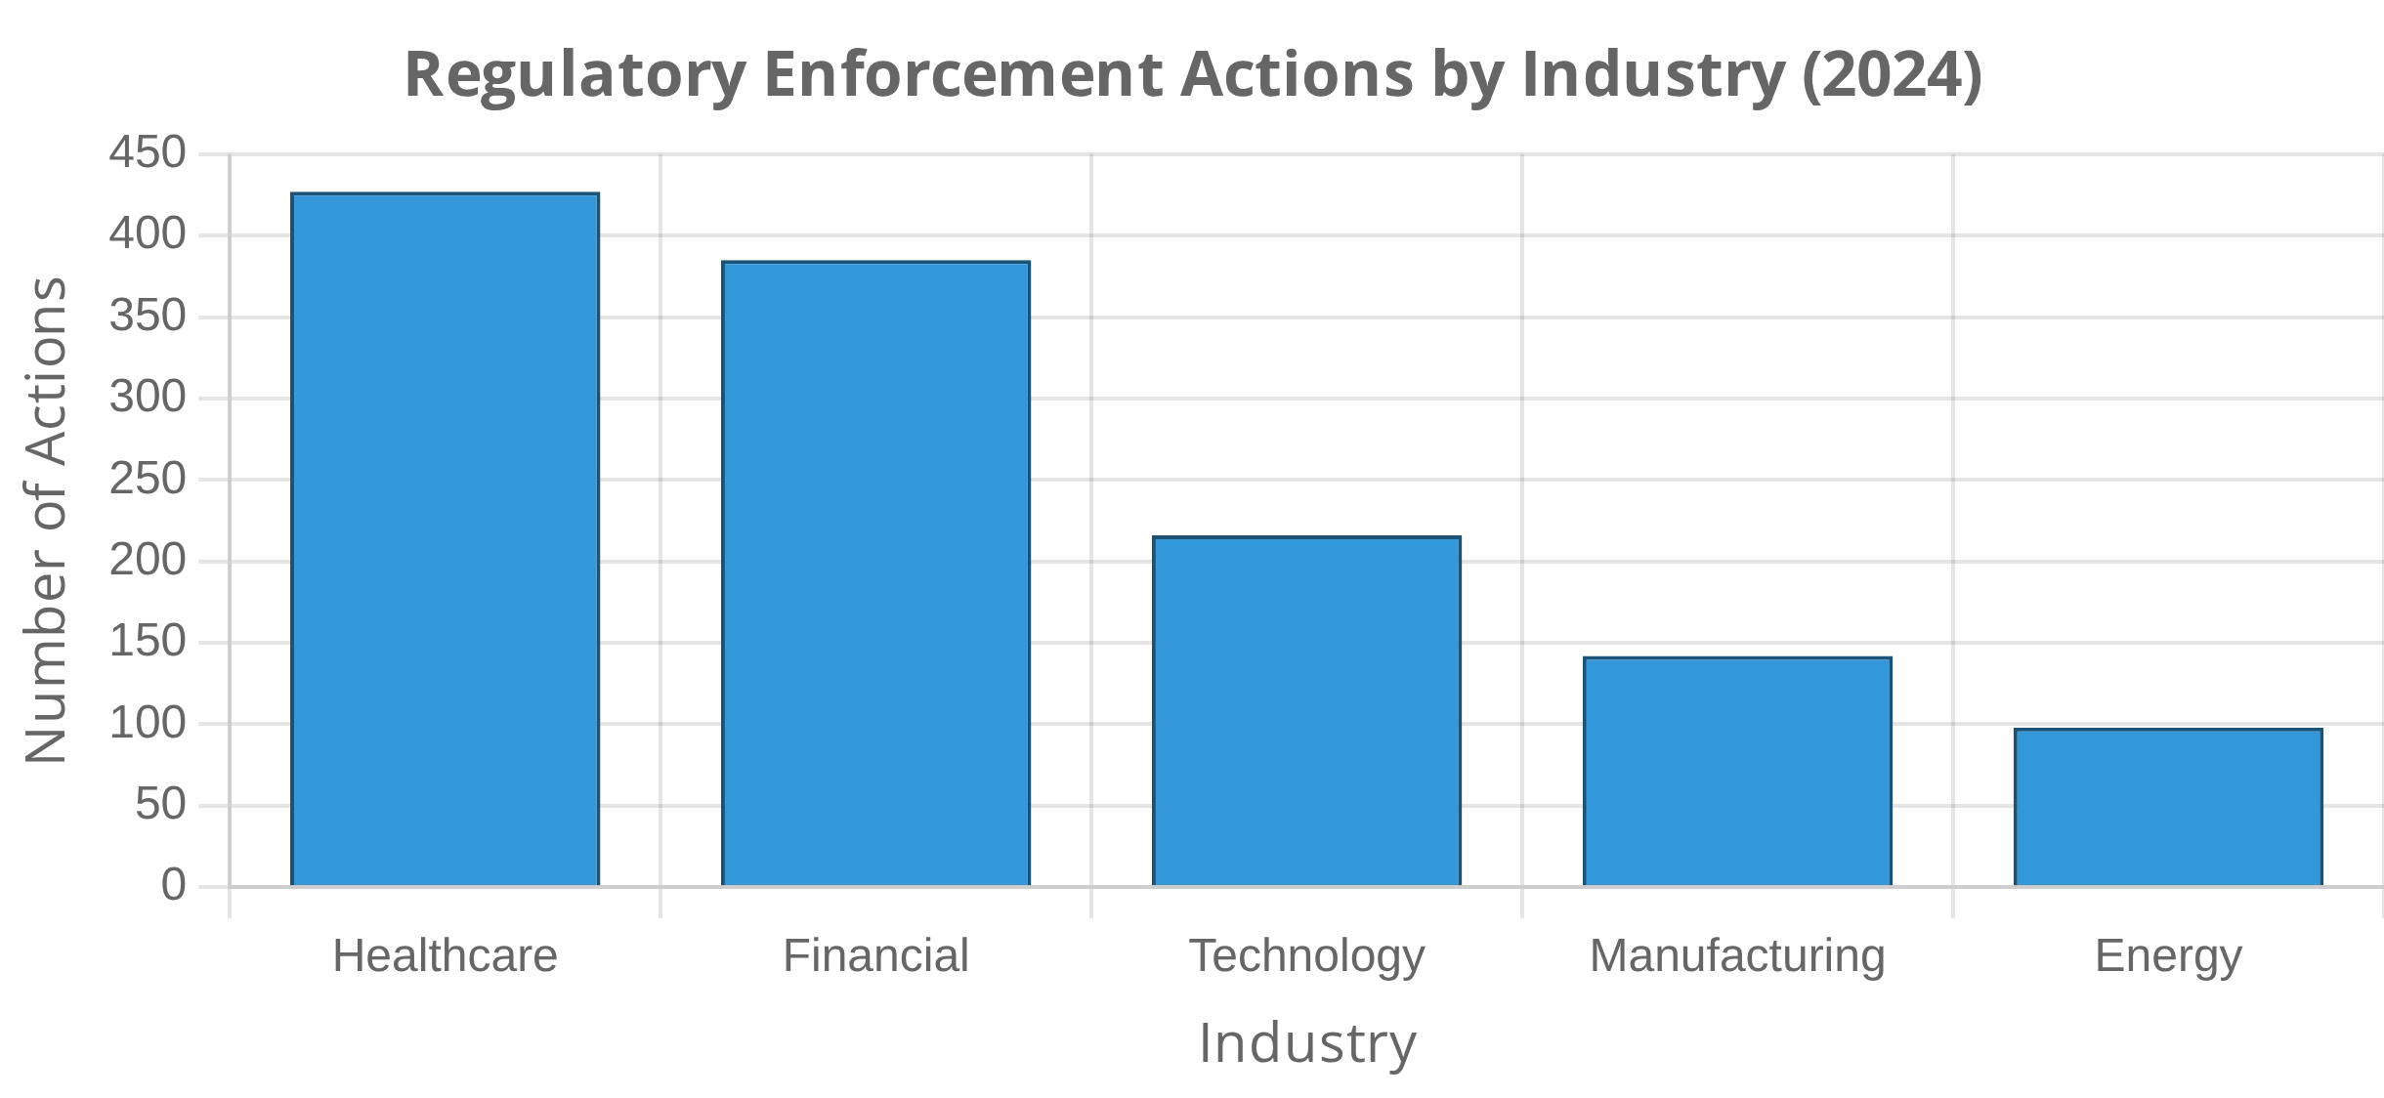
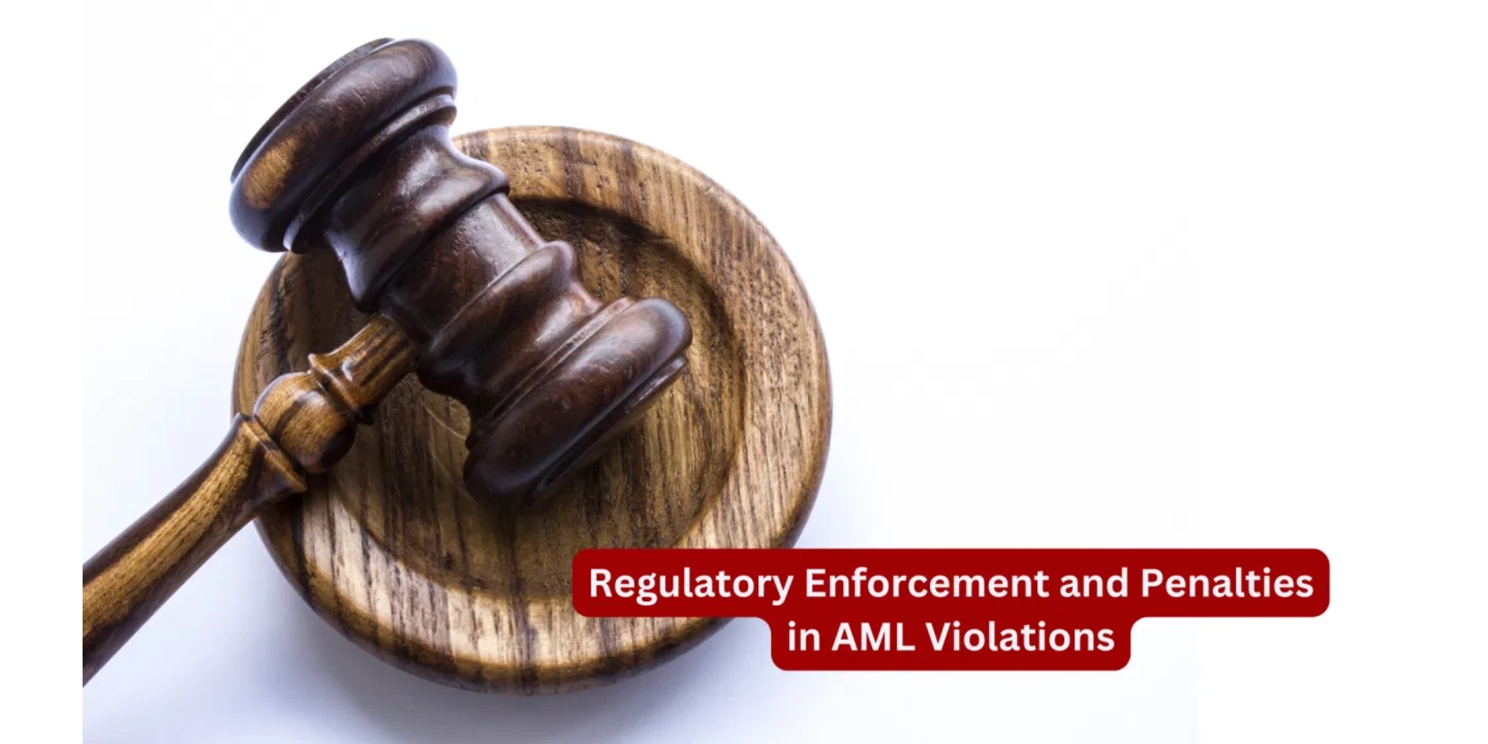
Industry-Specific Legal Implications
Technology Sector
Data Protection Laws:
GDPR, CCPA create complex compliance obligations
AI Governance:
New regulations addressing algorithmic transparency
Different industries face unique compliance requirements and corresponding legal implications for non-compliance. Understanding these industry-specific frameworks is essential for effective risk management.
Digital Markets:
Antitrust enforcement targeting platform dominance
Healthcare Industry
HIPAA Privacy Rules:
Govern protected health information with penalties up to $1.5M per violation
Anti-Kickback Statute:
Prohibits remuneration for referrals with criminal penalties
False Claims Act:
Imposes treble damages for fraudulent claims
Financial Services Industry
BSA/AML:
Requires monitoring systems with criminal penalties for violations
Securities Laws:
Impose disclosure obligations with SEC enforcement

Slide 11

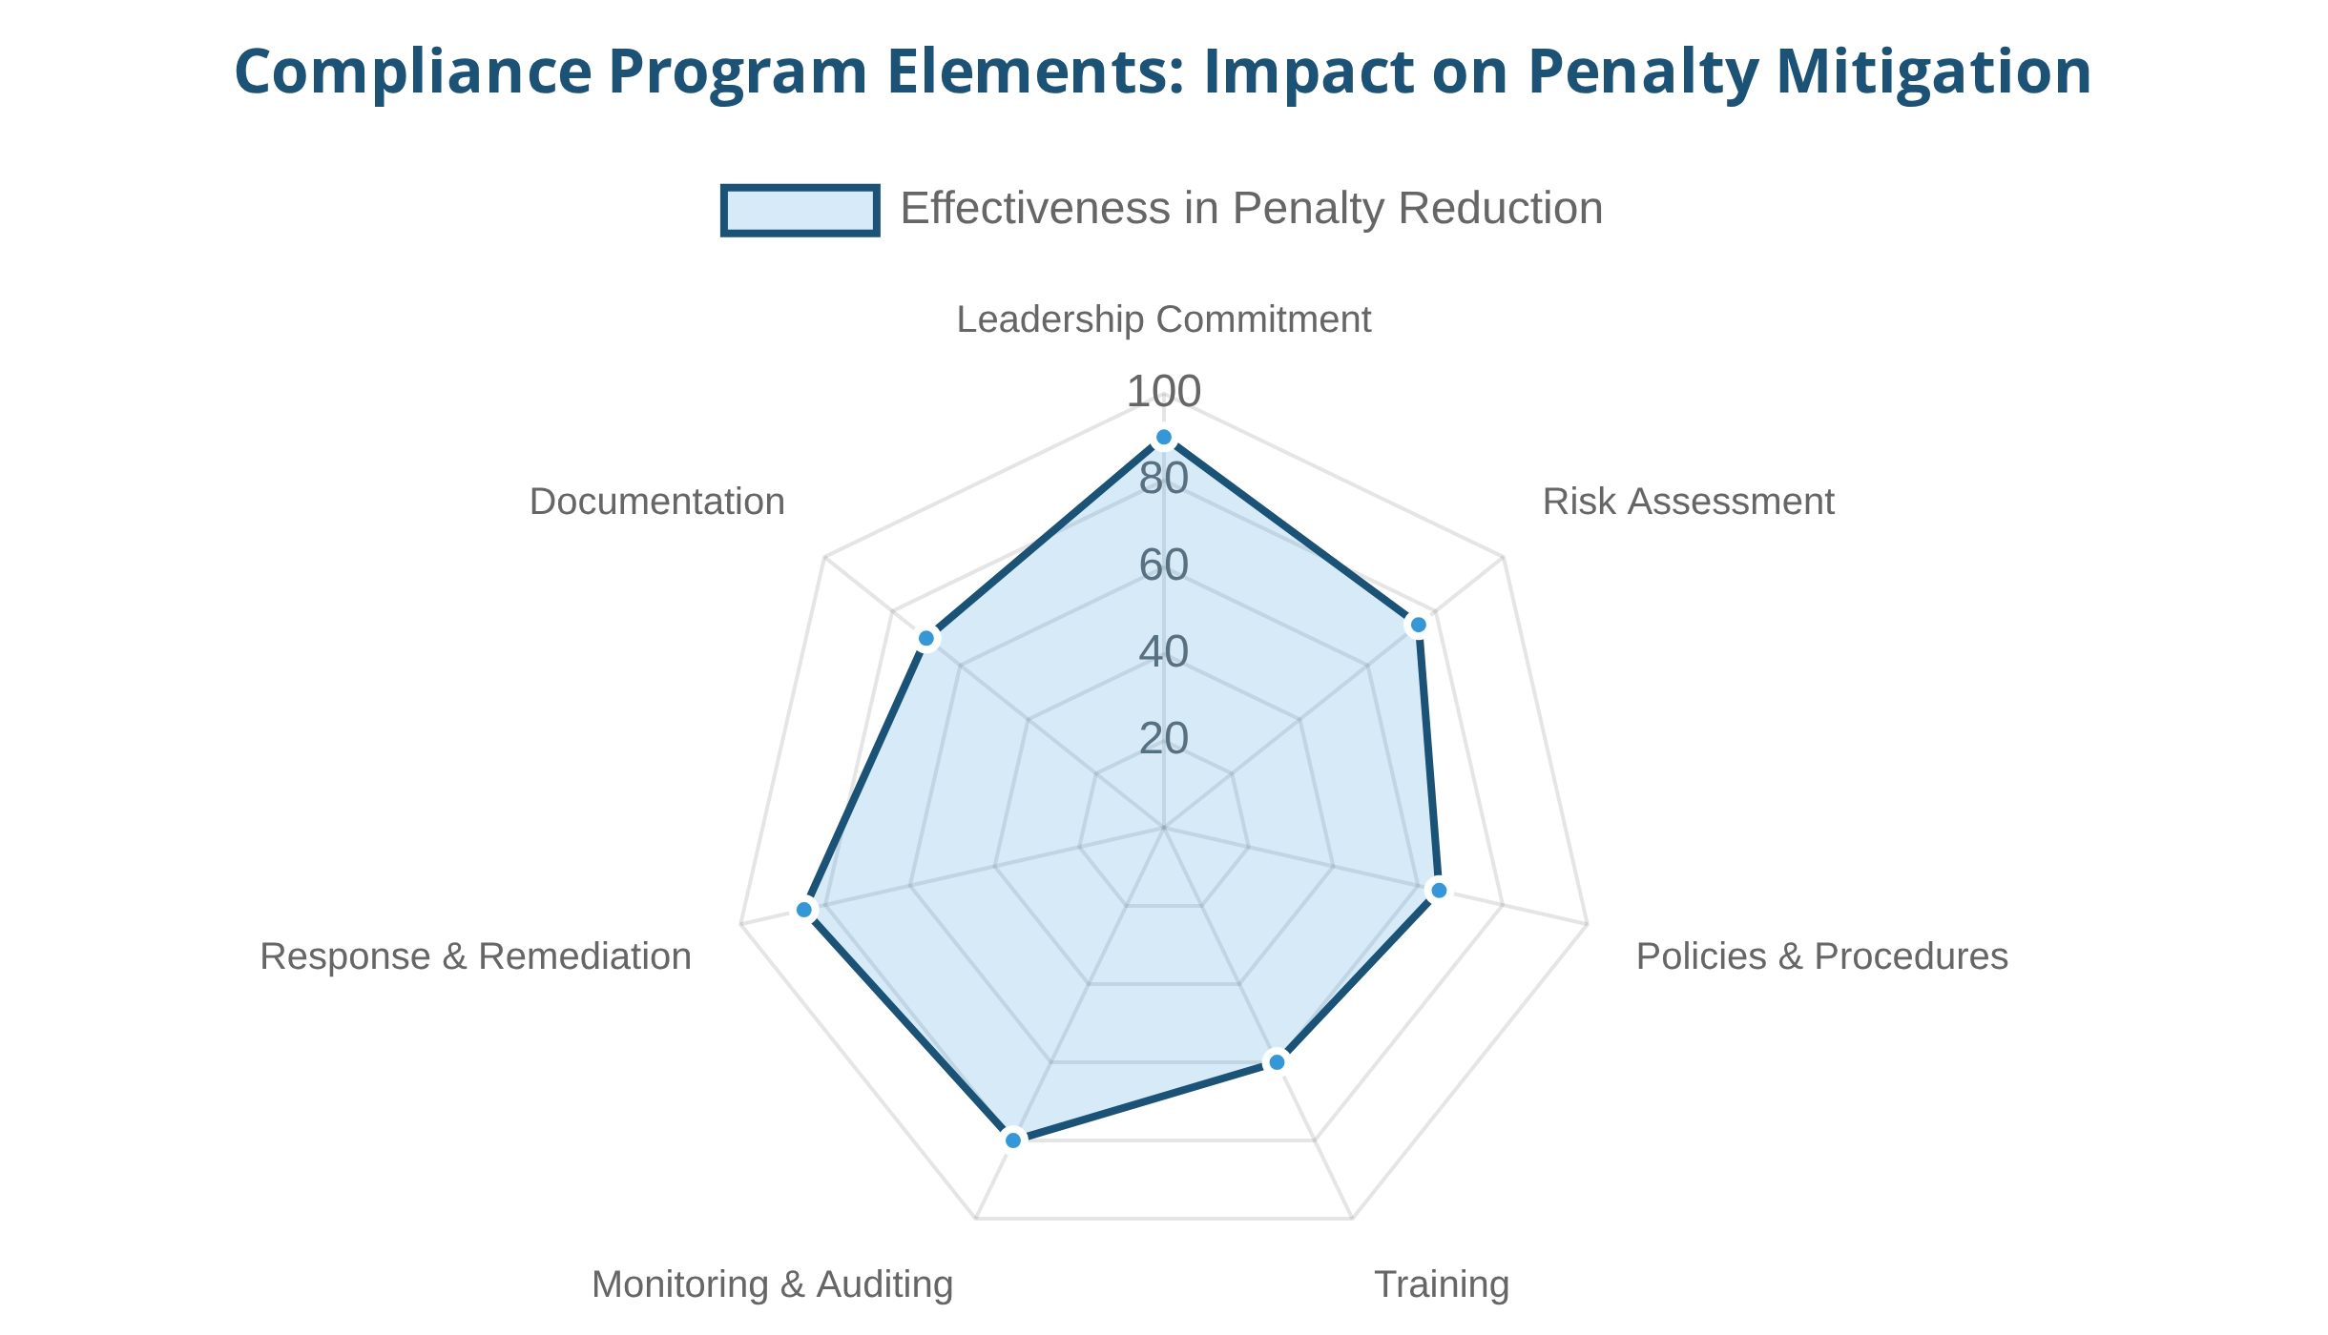




Mitigating Legal Risks
Organizations can significantly reduce their exposure to legal implications of non-compliance through structured risk management approaches. Effective mitigation strategies can both prevent violations and reduce penalties when issues do occur.
Effective Compliance Programs
Leadership Commitment
Senior management and board involvement in compliance oversight demonstrates organizational priority and establishes tone from the top.
Self-Disclosure Benefits
Risk Assessment Process
Voluntary self-disclosure of violations can substantially reduce penalties:
Systematic identification and evaluation of compliance risks enables targeted resource allocation.
DOJ Corporate Enforcement Policy offers presumption of declination for FCPA violations
Policies and Procedures
Clear, accessible guidance tailored to specific risk areas provides practical direction to employees.
SEC considers self-reporting as a key factor in penalty determinations
OFAC reduces base penalties by up to 50% for voluntary disclosures
Training and Communication
Documentation Importance
Role-specific education ensures employees understand compliance expectations relevant to their positions.
Maintaining comprehensive documentation of compliance efforts provides crucial evidence of good faith and due diligence, which can significantly impact enforcement outcomes and penalty determinations.

Slide 12




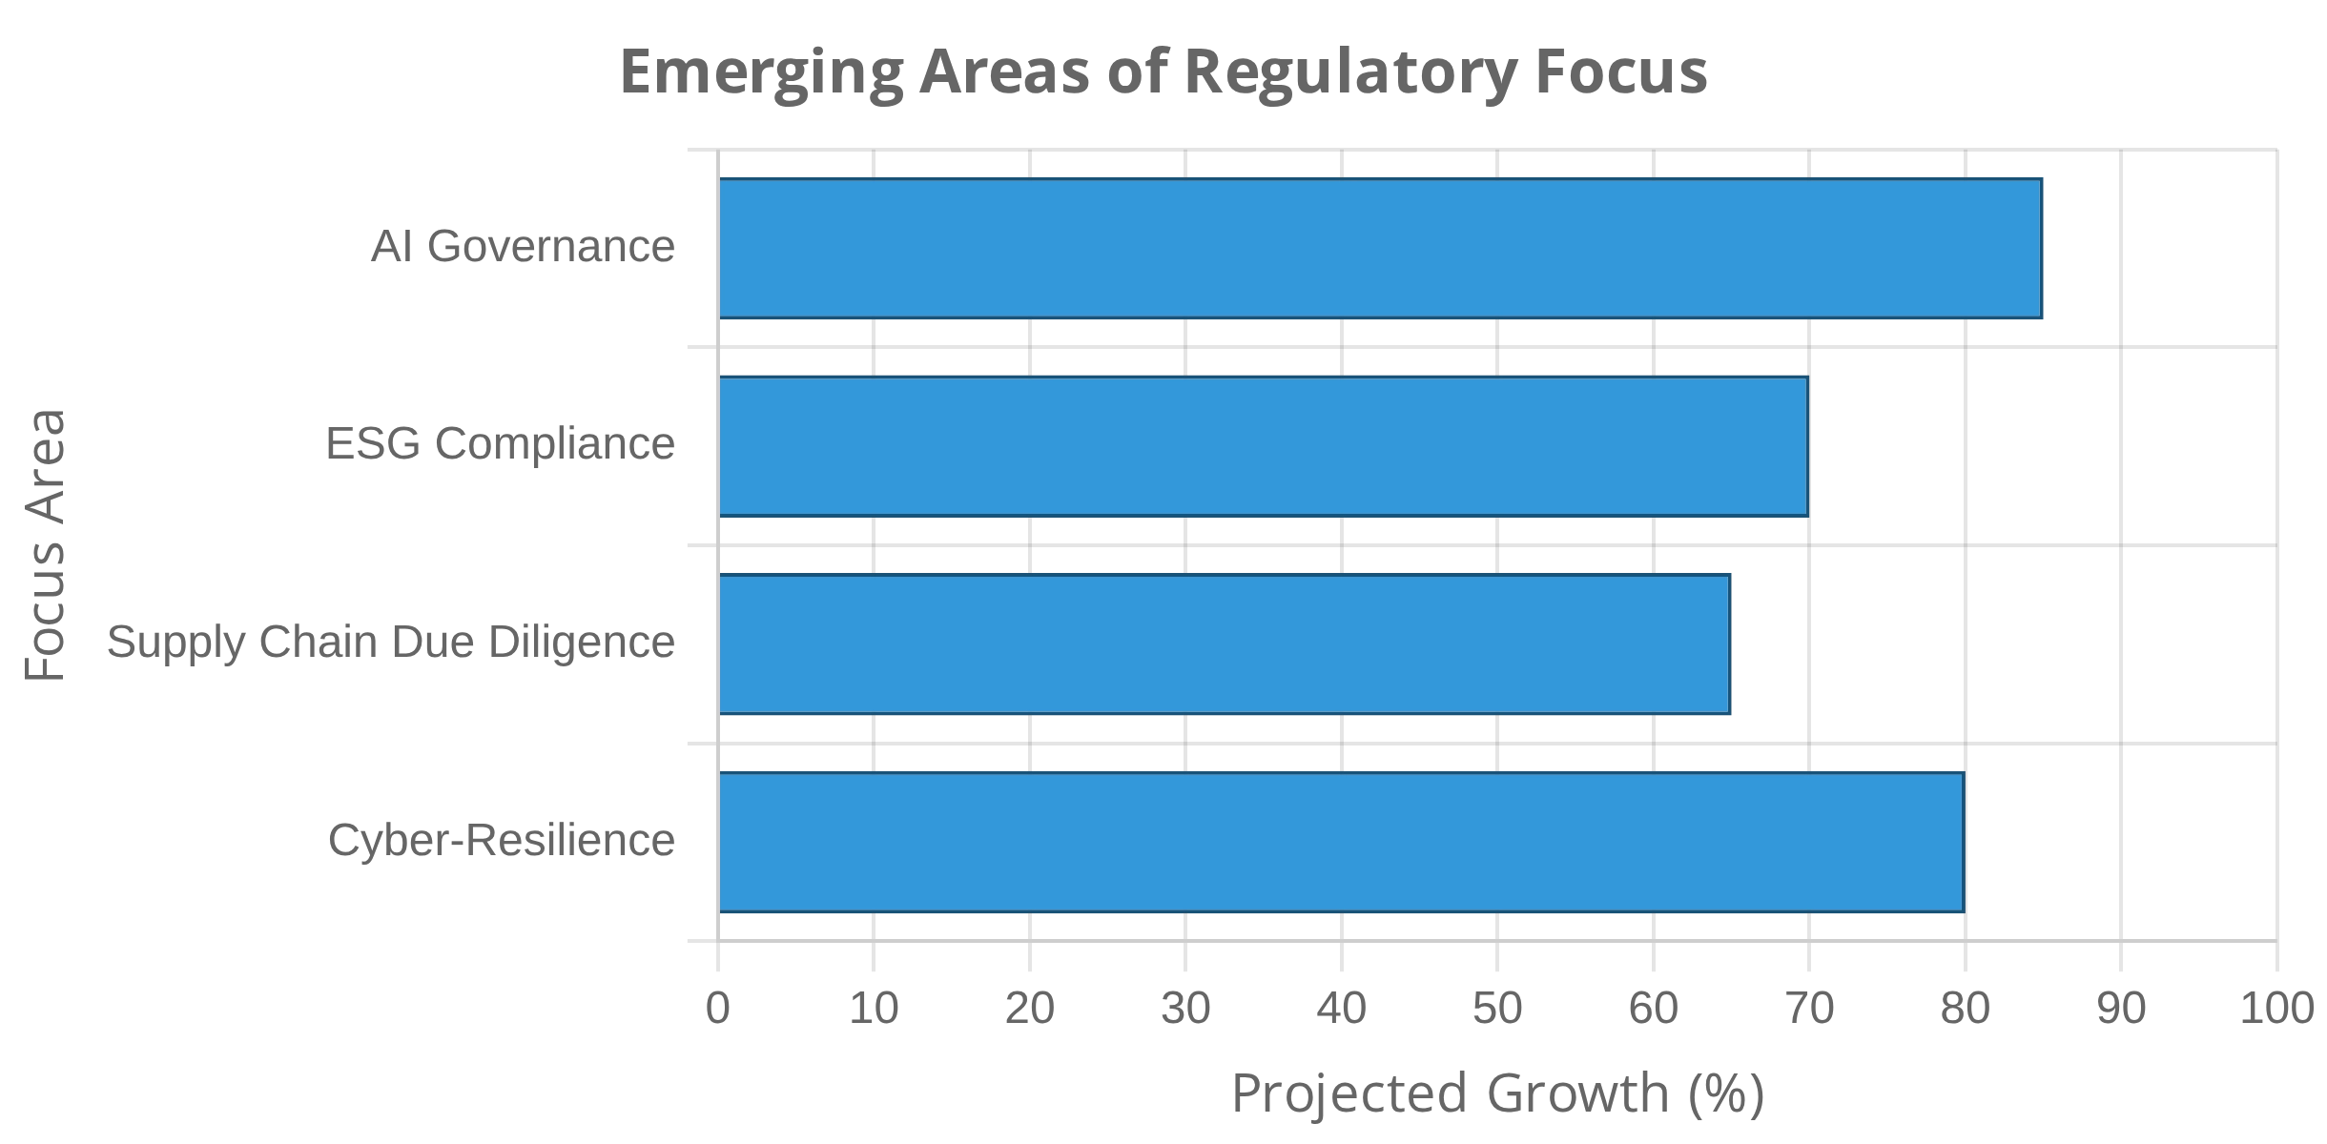


Conclusion
Key Takeaways
Non-compliance creates a complex web of legal implications that extend far beyond simple monetary penalties.
Regulatory authorities worldwide have significantly increased both the frequency and severity of enforcement actions.
Future Trends in Enforcement
The extraterritorial application of national laws has created overlapping and sometimes conflicting compliance obligations.
The costs of non-compliance substantially exceed the investments required for effective compliance programs.
Resources for Further Information
Department of Justice Evaluation of Corporate Compliance Programs
OECD Good Practice Guidance on Internal Controls, Ethics, and Compliance
Industry-specific regulatory guidance publications
International Organization for Standardization (ISO) compliance standards

